Slide 1
Super Smart Bros!
This is an app designed to give competitive players a resource to seek coaching to improve at the game.

Slide 2
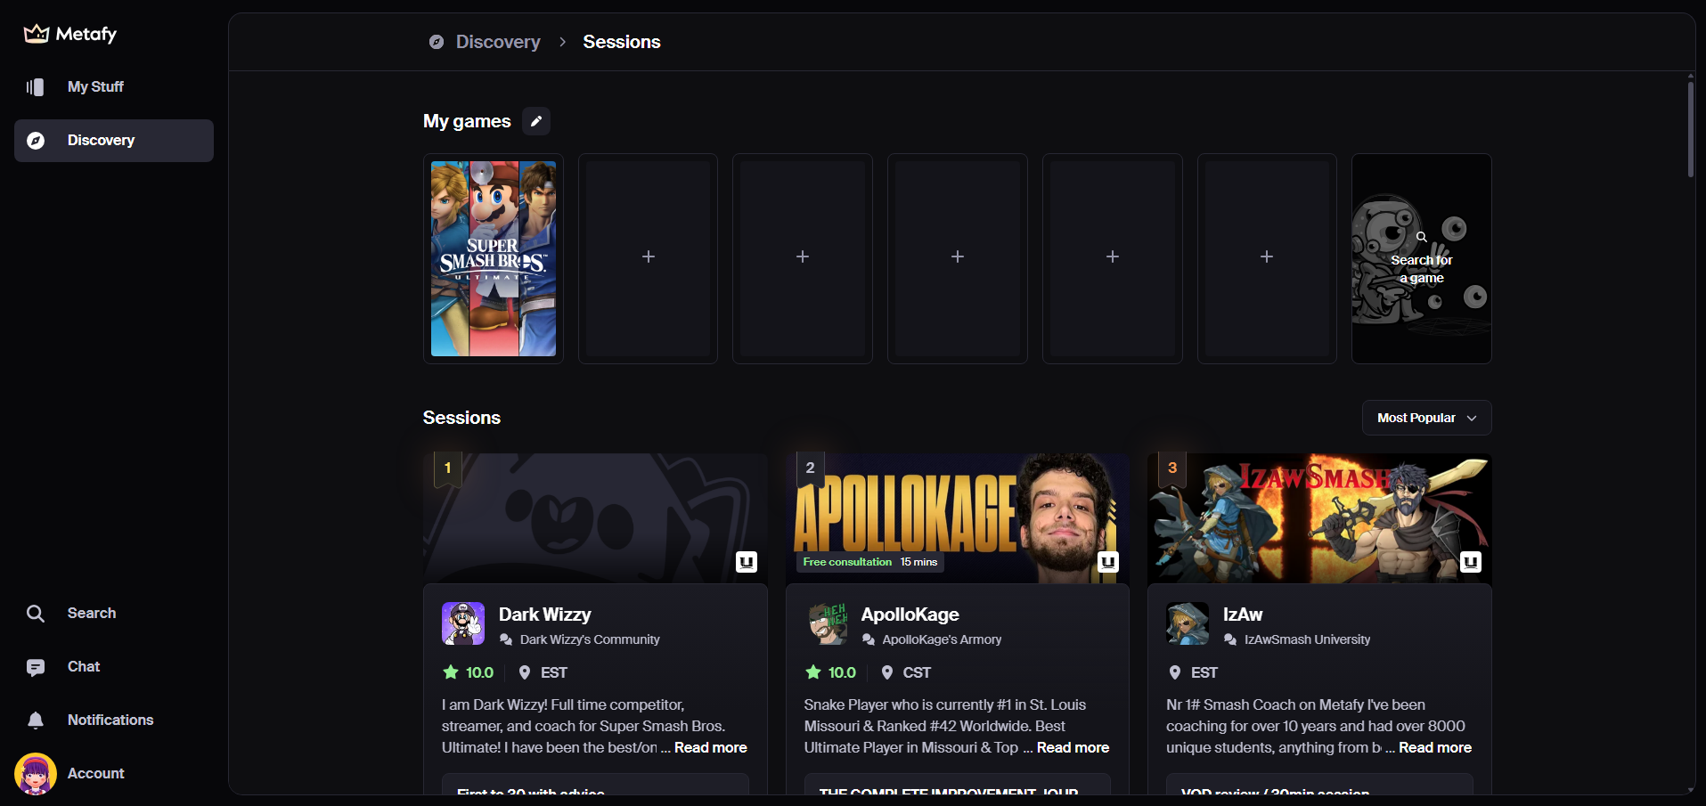

Slide 3
Coaching

